Slide 1
A typical M2M solution overview

Slide 2
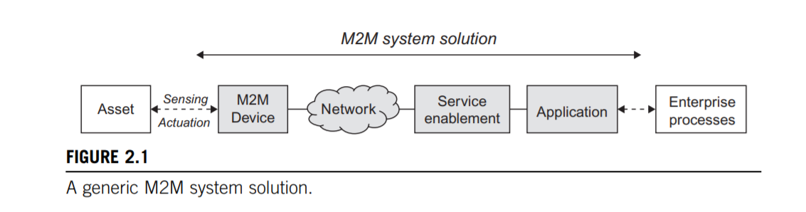
A typical M2M solution overview A typical M2M system solution consists of M2M devices, communication networks that provide remote connectivity for the devices, service enablement and application logic, and integration of the M2M application into the business processes provided by an Information Technology (IT) system of the enterprise, as illustrated below in

Slide 3
The system components of an M2M solution are as follows:
M2M Device
Network
M2M Service Enablement.
M2M Application

Slide 4
M2M Device
This is the M2M device attached to the asset of interest, and provides sensing and actuation capabilities. The M2M device is here generalized, as there are a number of different realizations of these devices, ranging from low-end sensor nodes to high-end complex devices with multimodal sensing capabilities

Slide 5
Network
The purpose of the network is to provide remote connectivity between the M2M device and the application-side servers. Many different network types can be used, and include both Wide Area Networks (WANs) and Local Area Networks (LANs), sometimes also referred to as Capillary Networks or M2M Area Networks. Examples of WANs are public cellular mobile networks, fixed private networks, or even satellite links.

Slide 6
M2M Service Enablement
Within the generalized system solution outlined above, the concept of a separate service enablement component is also introduced. This component provides generic functionality that is common across a number of different applications. Its primary purpose is to reduce cost for implementation and ease of application development. As we will see later , the emergence of service enablement as a separate system component is a clear trend.

Slide 7
M2M Application
The application component of the solution is a realization of the highly specific monitor and control process. The application is further integrated into the overall business process system of the enterprise. The process of remotely monitoring and controlling assets can be of many different types, for instance, remote car diagnostics or electricity meter data management.

Slide 8
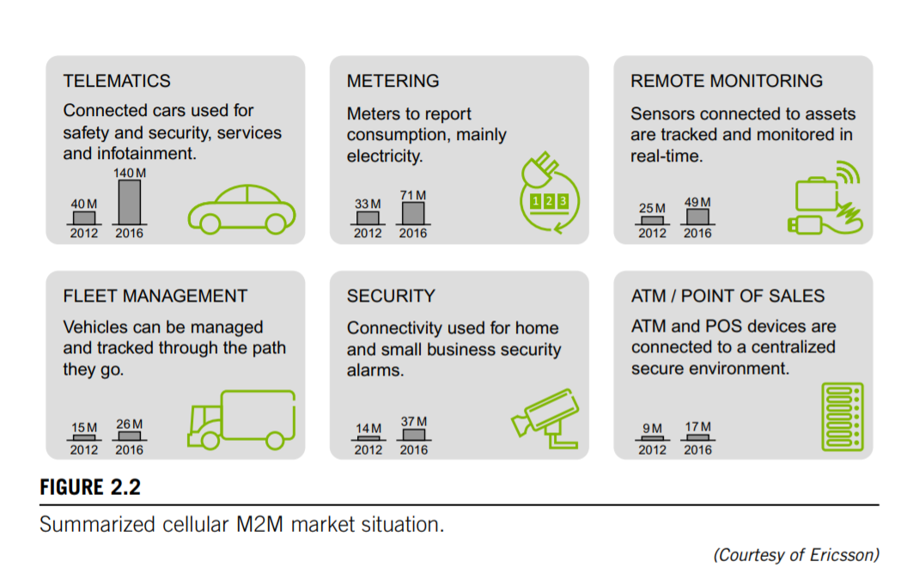

Slide 9
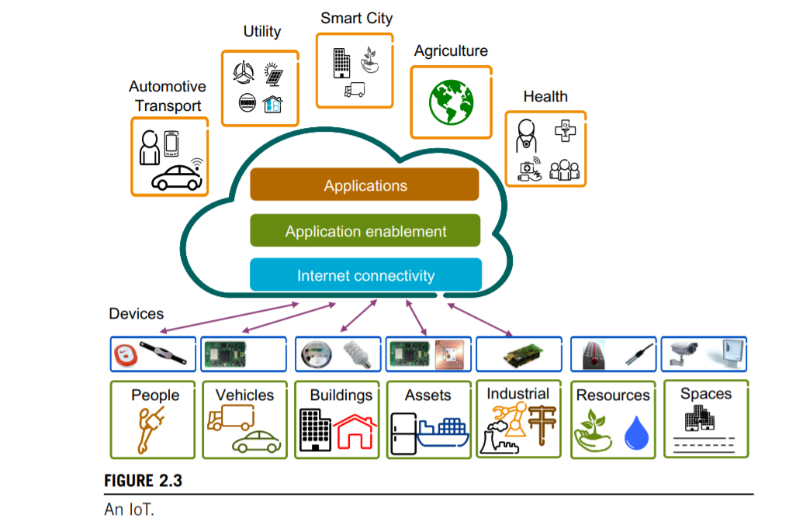

Slide 10
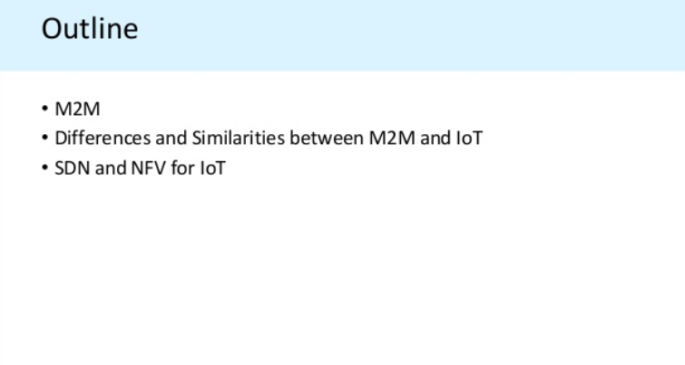

Slide 11
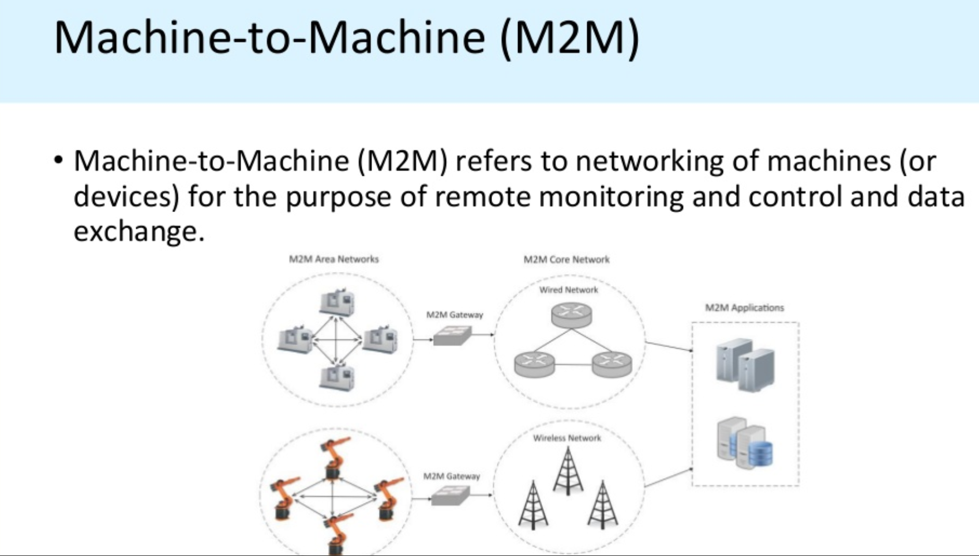

Slide 12
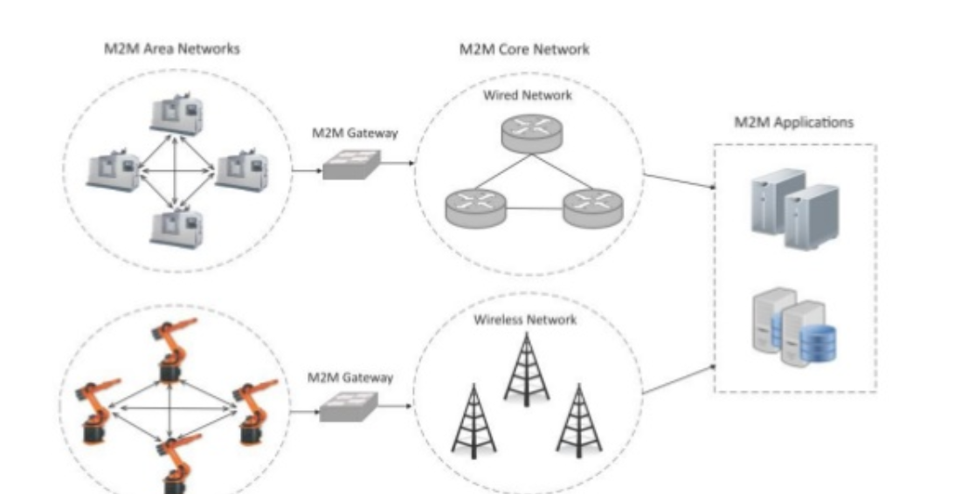

Slide 13
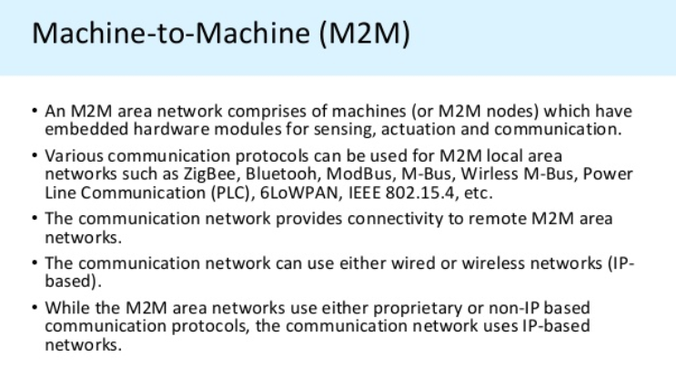

Slide 14
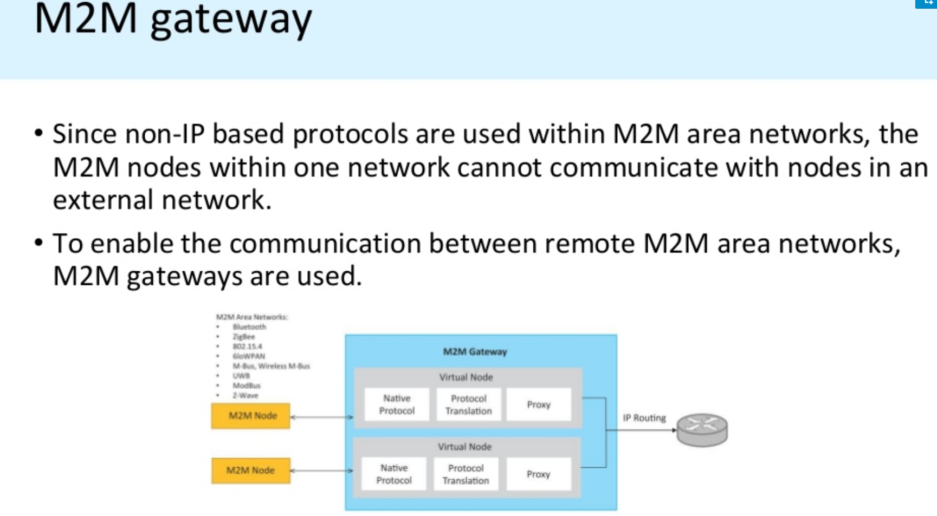

Slide 15
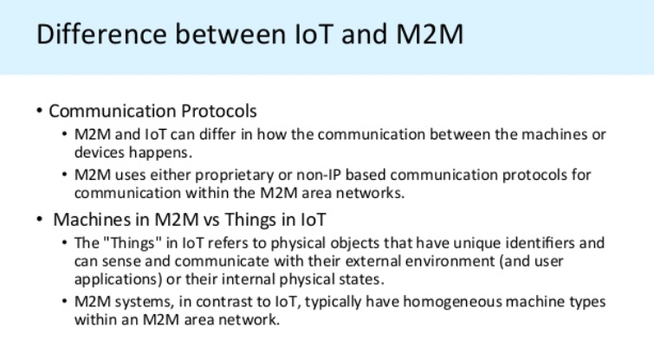

Slide 16
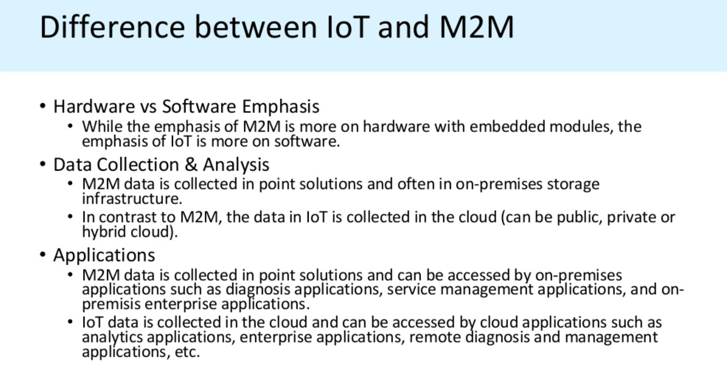

Slide 17
